Slide 1
DESIGN OF AN 8:1 ANALOG MULTIPLEXER
Course No: EEE 466
Course Name: Analog Integrated Circuit Laboratory
Group No: 04
Group Members: 1906066,1906072,1906076, 1906077
Course Instructors:
Dr Muhammad Abdullah Arafat Nafis Sadik Assistant Professor Lecturer
EEE,BUET EEE,BUET

Slide 2
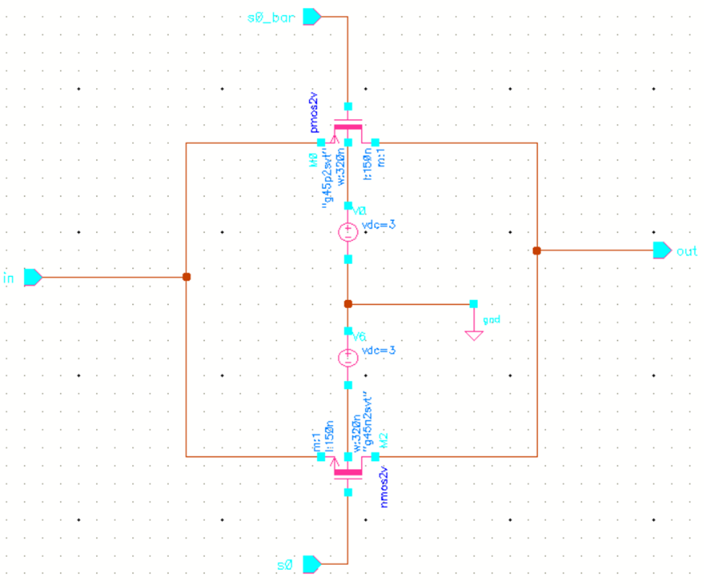
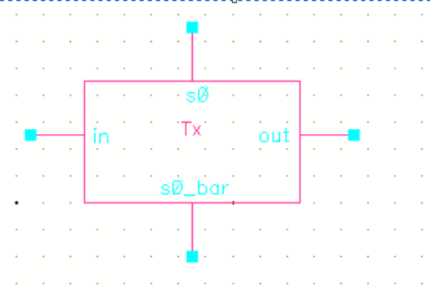
TRANSMISSION GATE

Slide 3
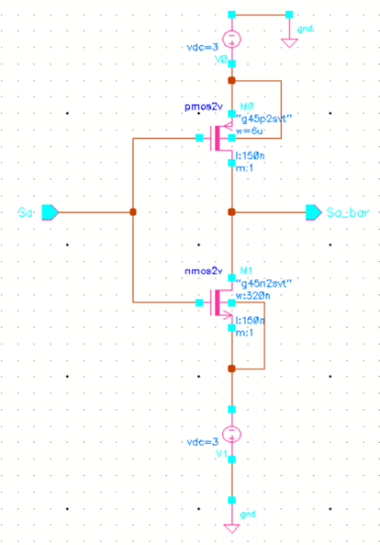
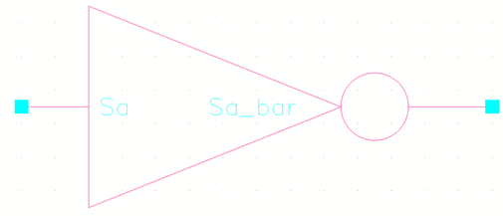
INVERTER

Slide 4
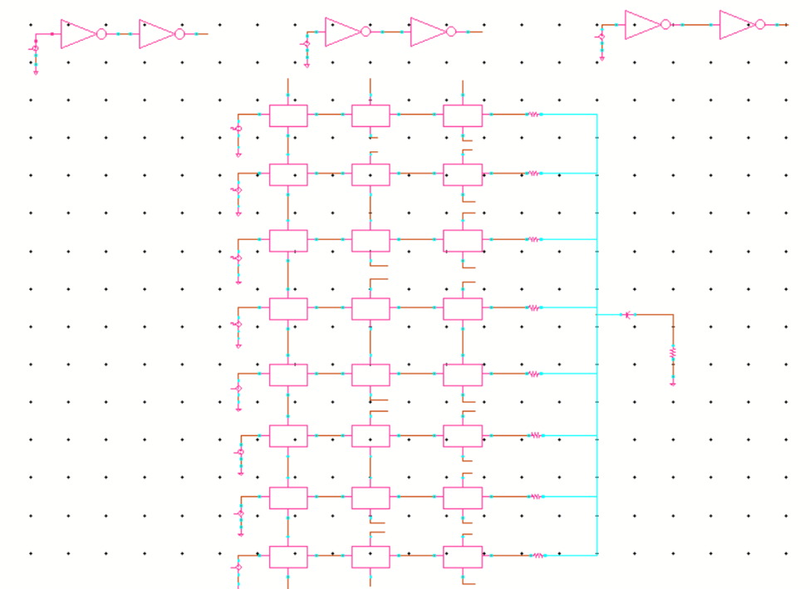
FULL CIRCUIT

Slide 5
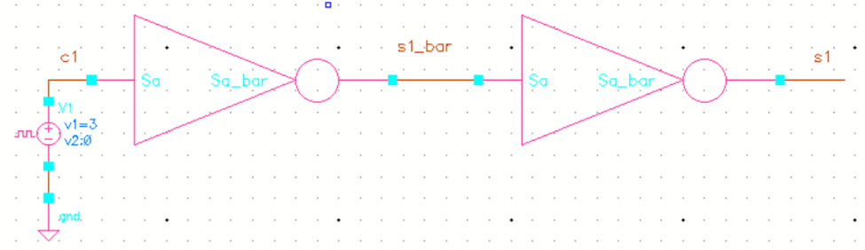
Control Signal

Slide 6
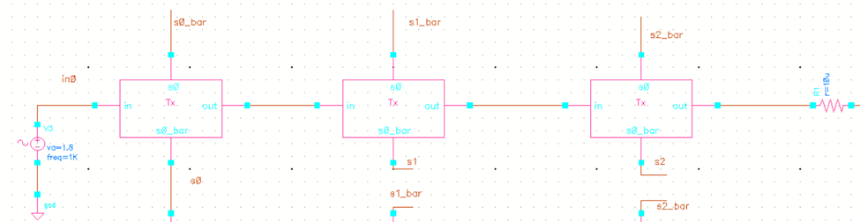
We have put small resistor at the end to get rid of warning.

Slide 7
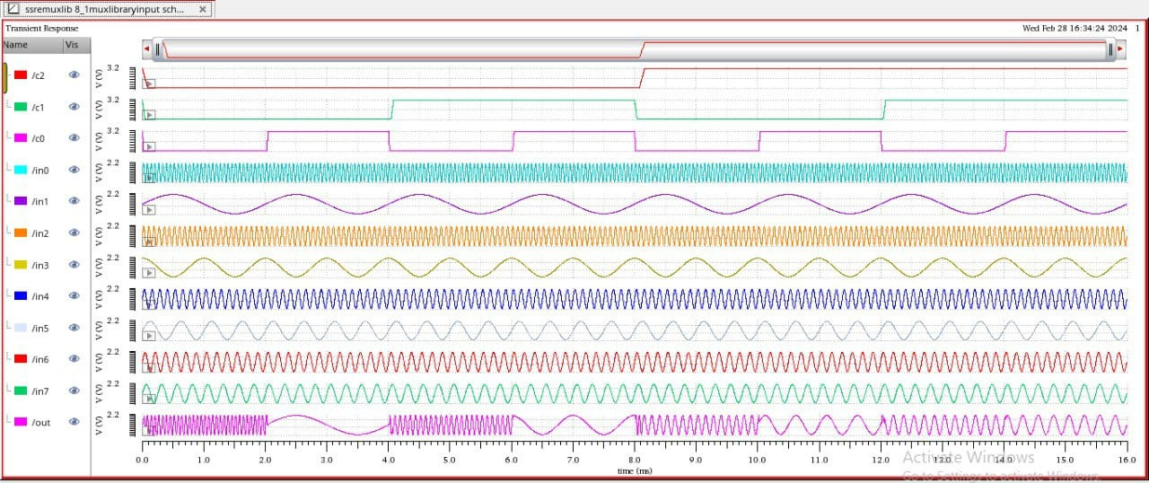
FINAL OUTPUT

Slide 8
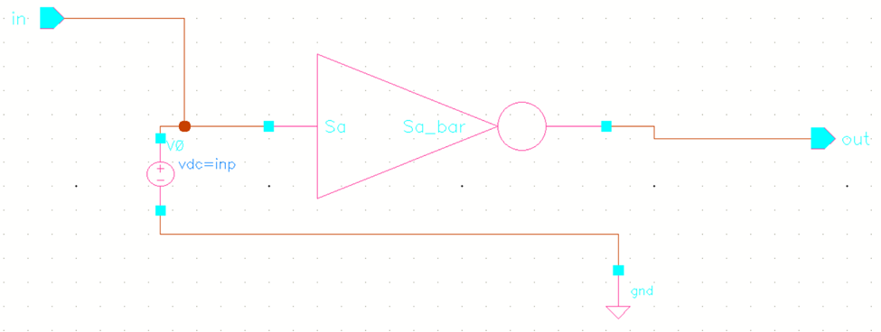
SPECIFICATIONS
1. LOGIC HIGH AND LOW LEVEL
We are changing finger width of PMOS to make the transition sharper.

Slide 9
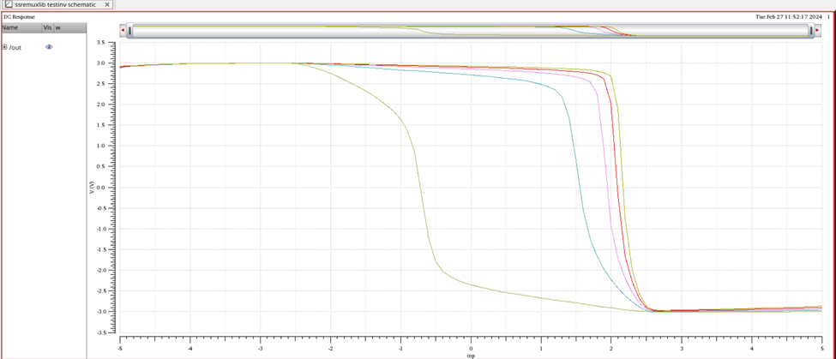
Varying width of PMOS

Slide 10
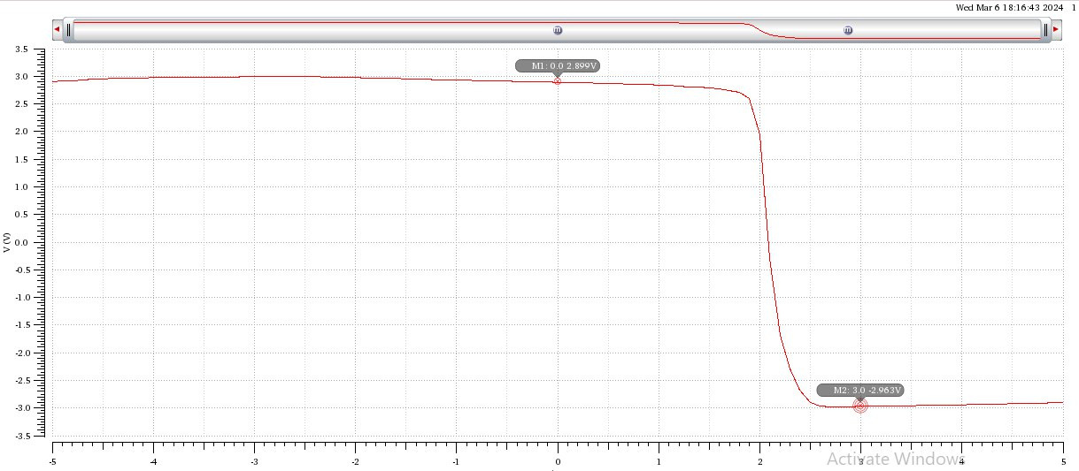
We got perfect transition with W=6um. So, the inverter will work around 0 to 3V.

Slide 11
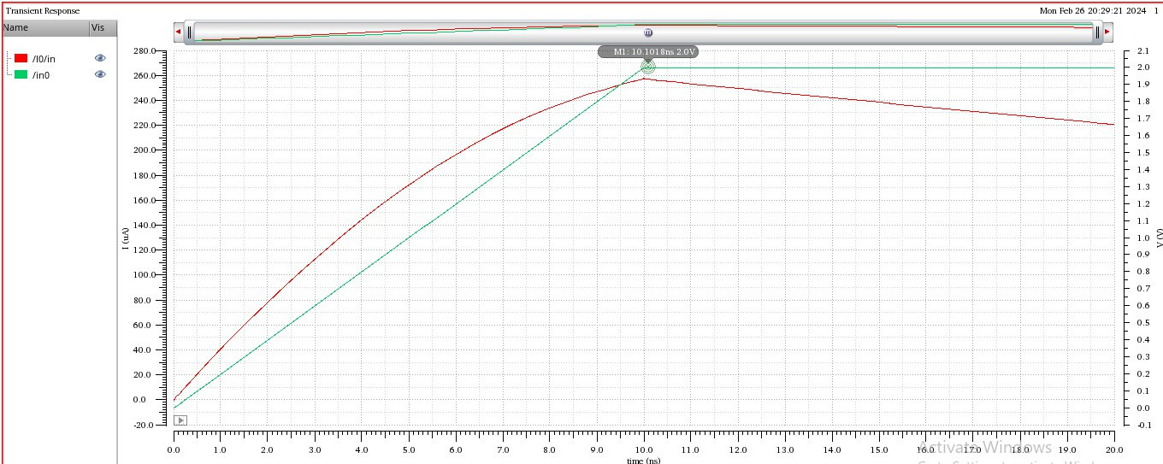
2. INPUT CAPACITANCE

Slide 12
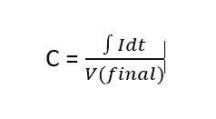
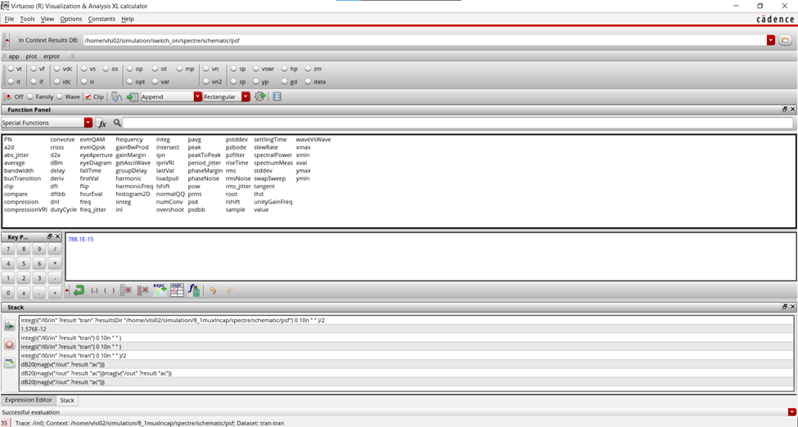
Input Capacitance = 0.7881 pF.
Given max capacitance is 50 pF. So, specification is met.

Slide 13
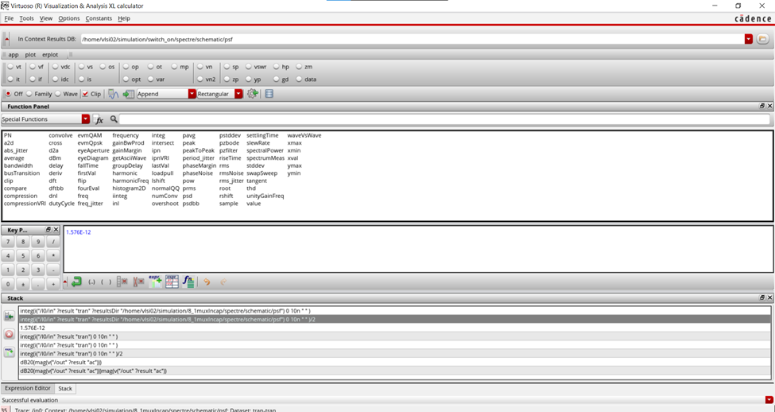
3. CHARGE INJECTION OVER THE FULL SIGNAL SWING RANGE
Injected Charge :1.576 pC which meets the specification.

Slide 14
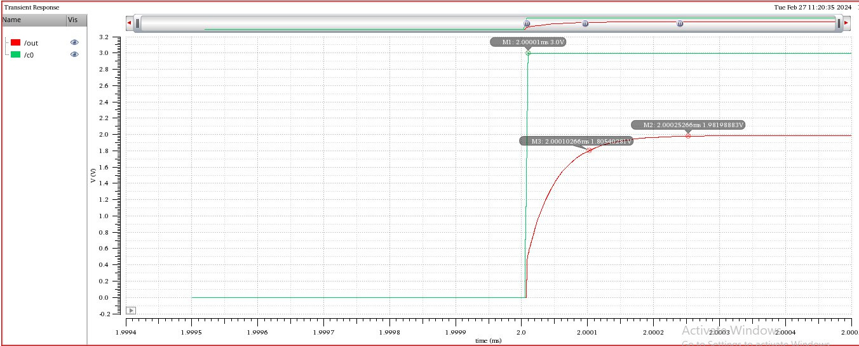
4. SWITICHING TIME (TON)
Switching on time = 92.66ns

Slide 15
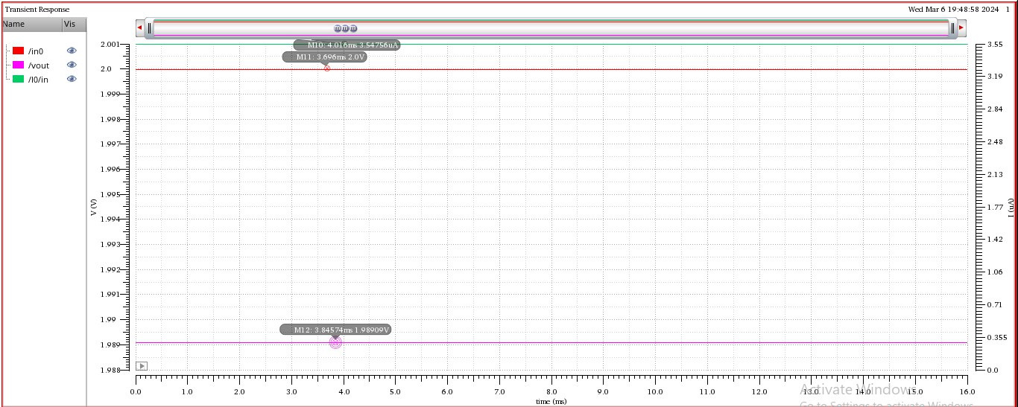
5. POWER DISSIPATION
P = Vin * I = 2 * 3.54756 uA = 7.09512 uW

Slide 16
6. ON-RESISTANCE
Ron = (2 - 1.98909) / 3.54756 u = 3075.353 ohm

Slide 17
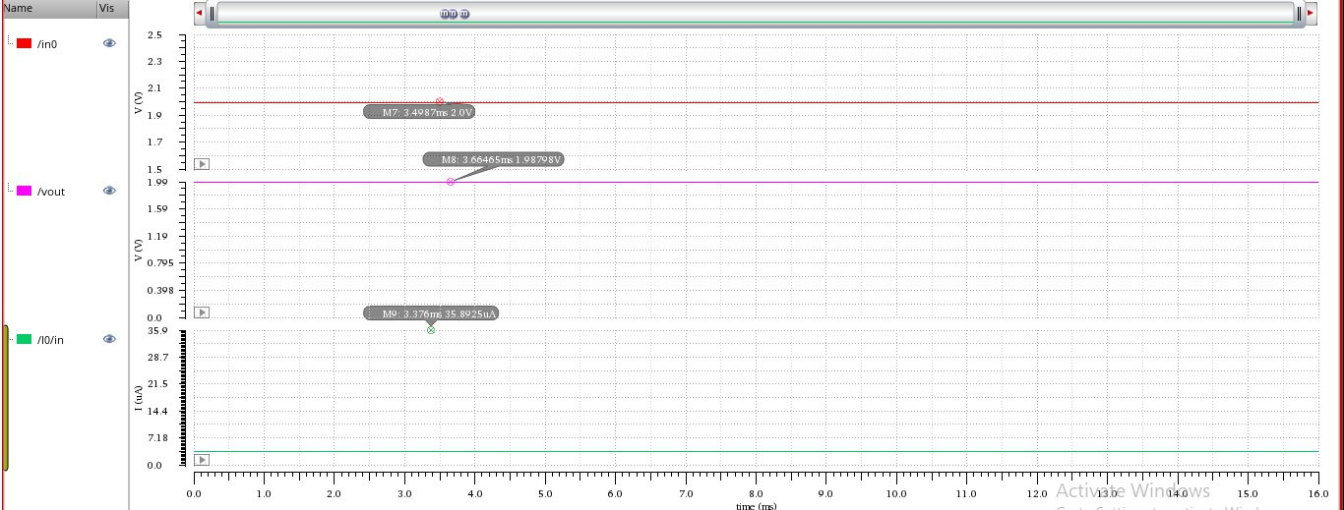
MODIFIED CIRCUIT
Ron = 337.1178 ohm
Dissipated Power = 71.785 uW

Slide 18
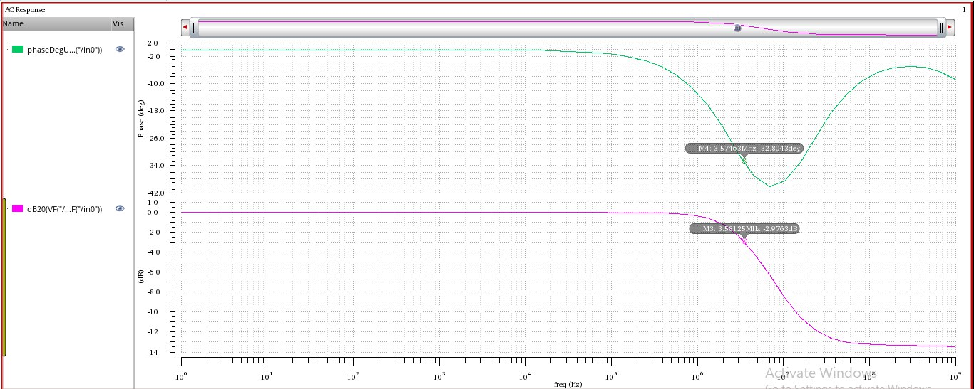
8. BANDWIDTH
Bandwidth is around 3.5 MHz. Specification given is 1MHz. We managed to get better bandwidth than given sepcification which ensures better performance.

Slide 19
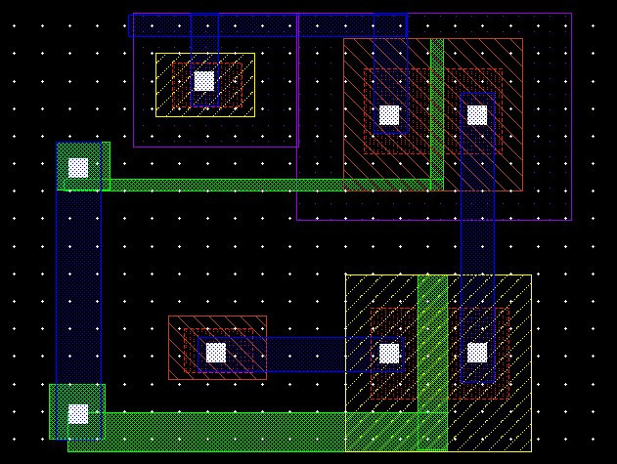
LAYOUT
Layout of inverter circuit

Slide 20
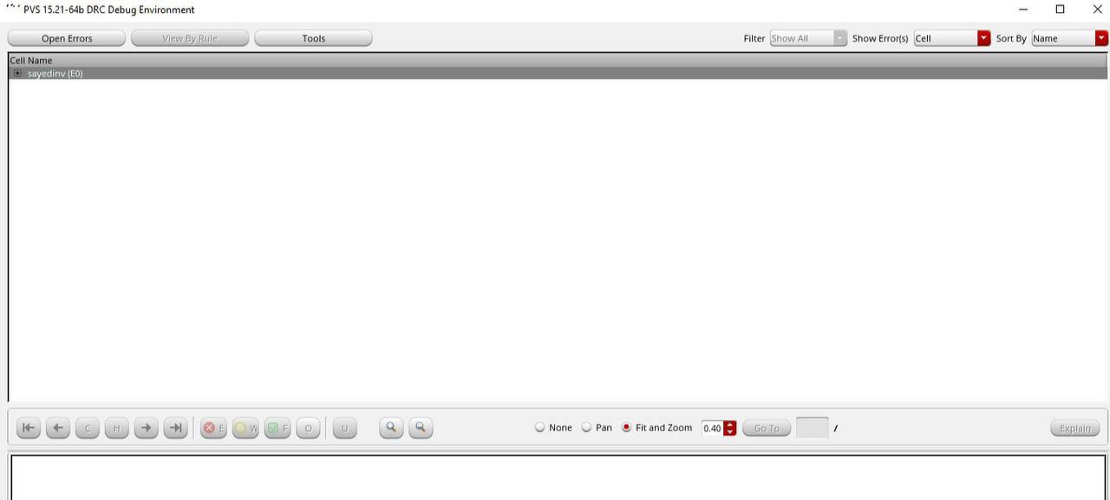
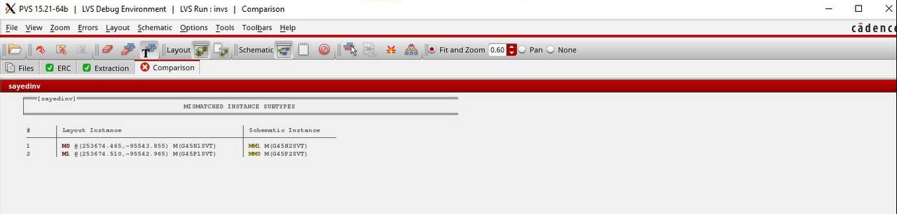

Slide 21
Comparison
Specifications | Given | Calculated
Logic High & Low Level | 1.4 V & 0V | 3 V & 0 V
Input Capacitance(max) | 50 pF | 0.7881 pF
Charge Injection over full signal swing range(max) | 5 pC | 1.576 pC
Switching On time (max) | 100 ns | 92.66 ns
Analog Signal Range | -2 to 2 | -2 to 2 V
Power Dissipation (max) | 10 mW | 7.09512 uW
On-Resistance | 10 ohm | 3075.353 ohm (modified 337.1178 ohm)
Bandwidth, -3 dB | 1 MHz | 3.5 MHz

Slide 22
References
https://research.ijcaonline.org/volume99/number5/pxc3897911.pdf
http://ijmemr.org/Publication/V2I2/IJMEMR-V2I2-002.pdf
https://www.youtube.com/watch?v=Z7mX3A5C8g4

Slide 23
THANK YOU

